Slide 1
PREDICTING STOCK MARKET TRENDS ON VIDEO-GAME COMPANY STOCK DATA

Slide 2
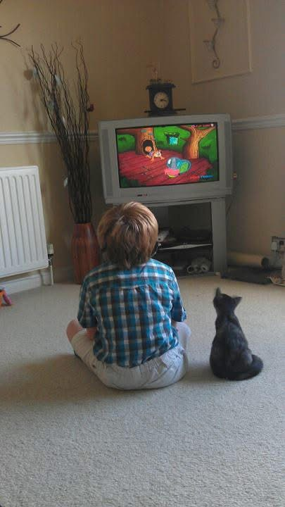
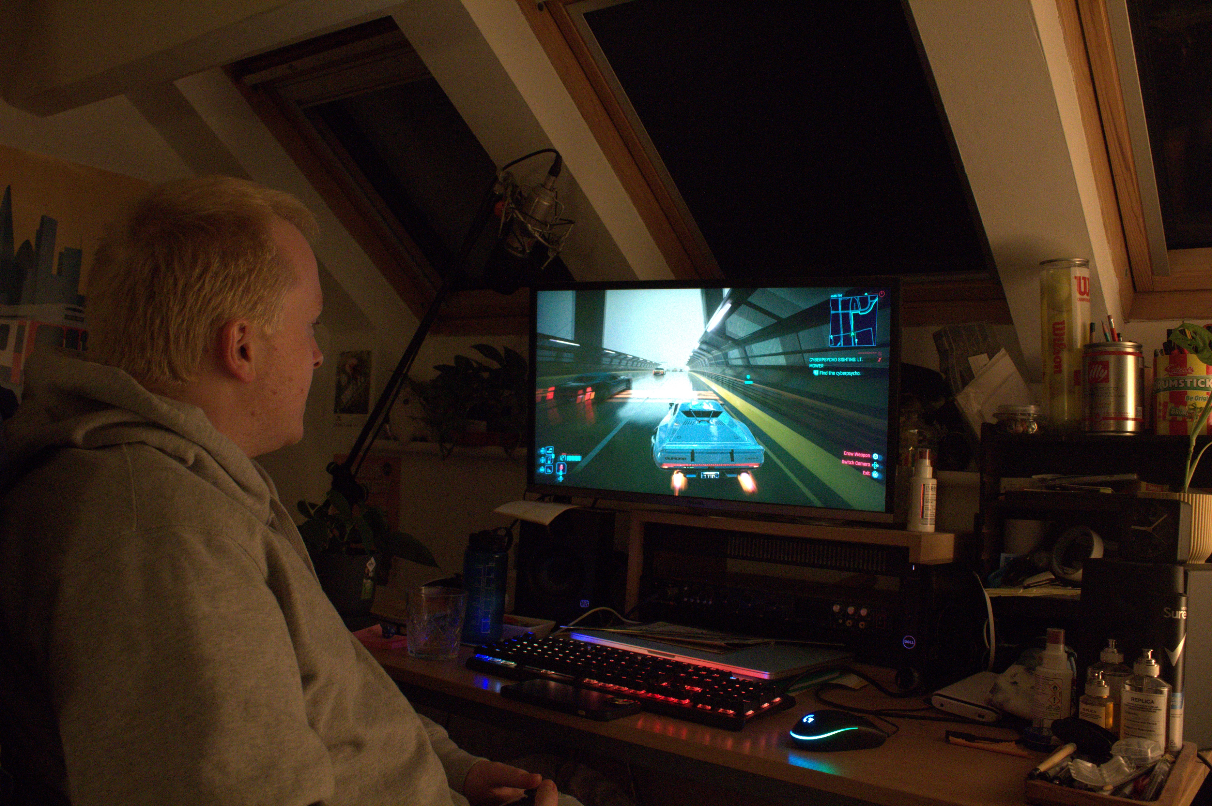
Background
Me Aged 8 (2011)
Me Aged 22 (2025)

Slide 3
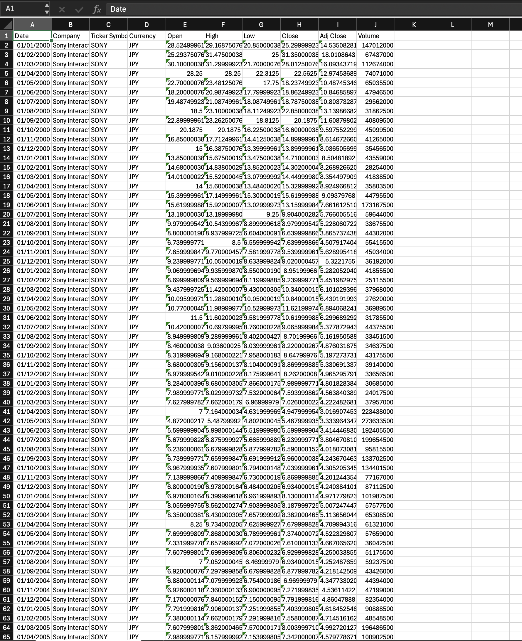
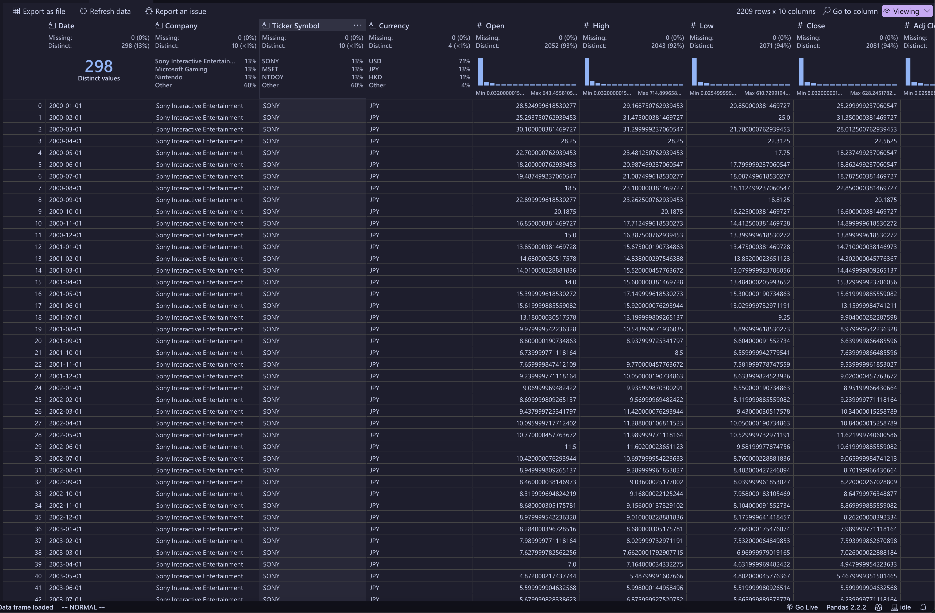
Data

Slide 4
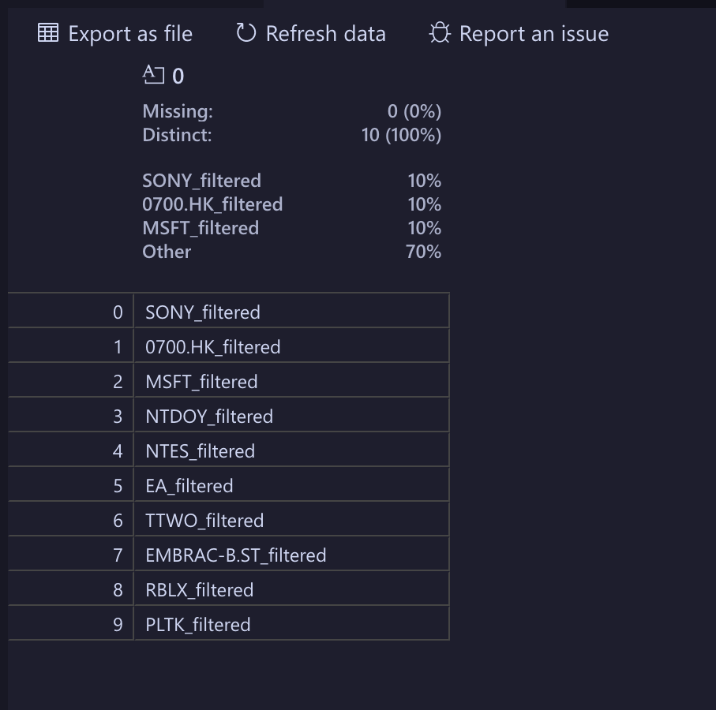
Company/Stock Tickers

Slide 5
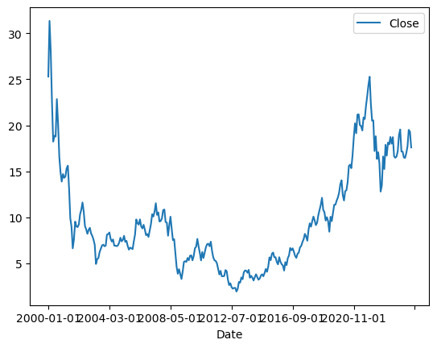
Basic Plot of ‘Close’ Value
SONY Release History (2000 – 2024)
PS2 - October 2000
PSP - December 2004
PS3 - November 2006
PS Vita - February 2012
PS4 - November 2013
PS4 Pro - November 2016
PS5 - November 2020

Slide 6
Basic Plot of ‘Close’ Value
SONY Release History (2000 – 2024)
PS2 - October 2000
PSP - December 2004
PS3 - November 2006
PS Vita - February 2012
PS4 - November 2013
PS4 Pro - November 2016
PS5 - November 2020

Slide 7
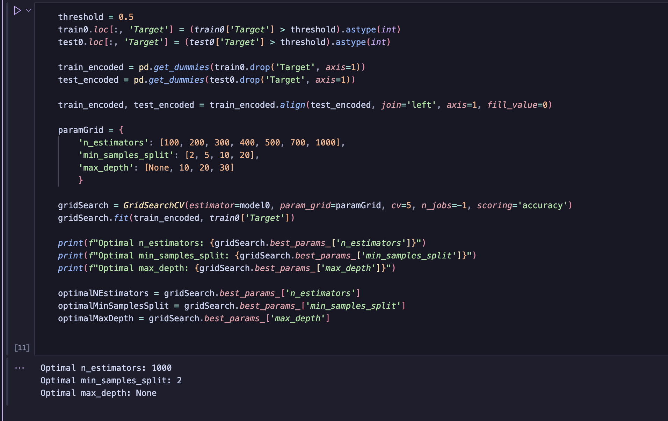
Optimisation

Slide 8
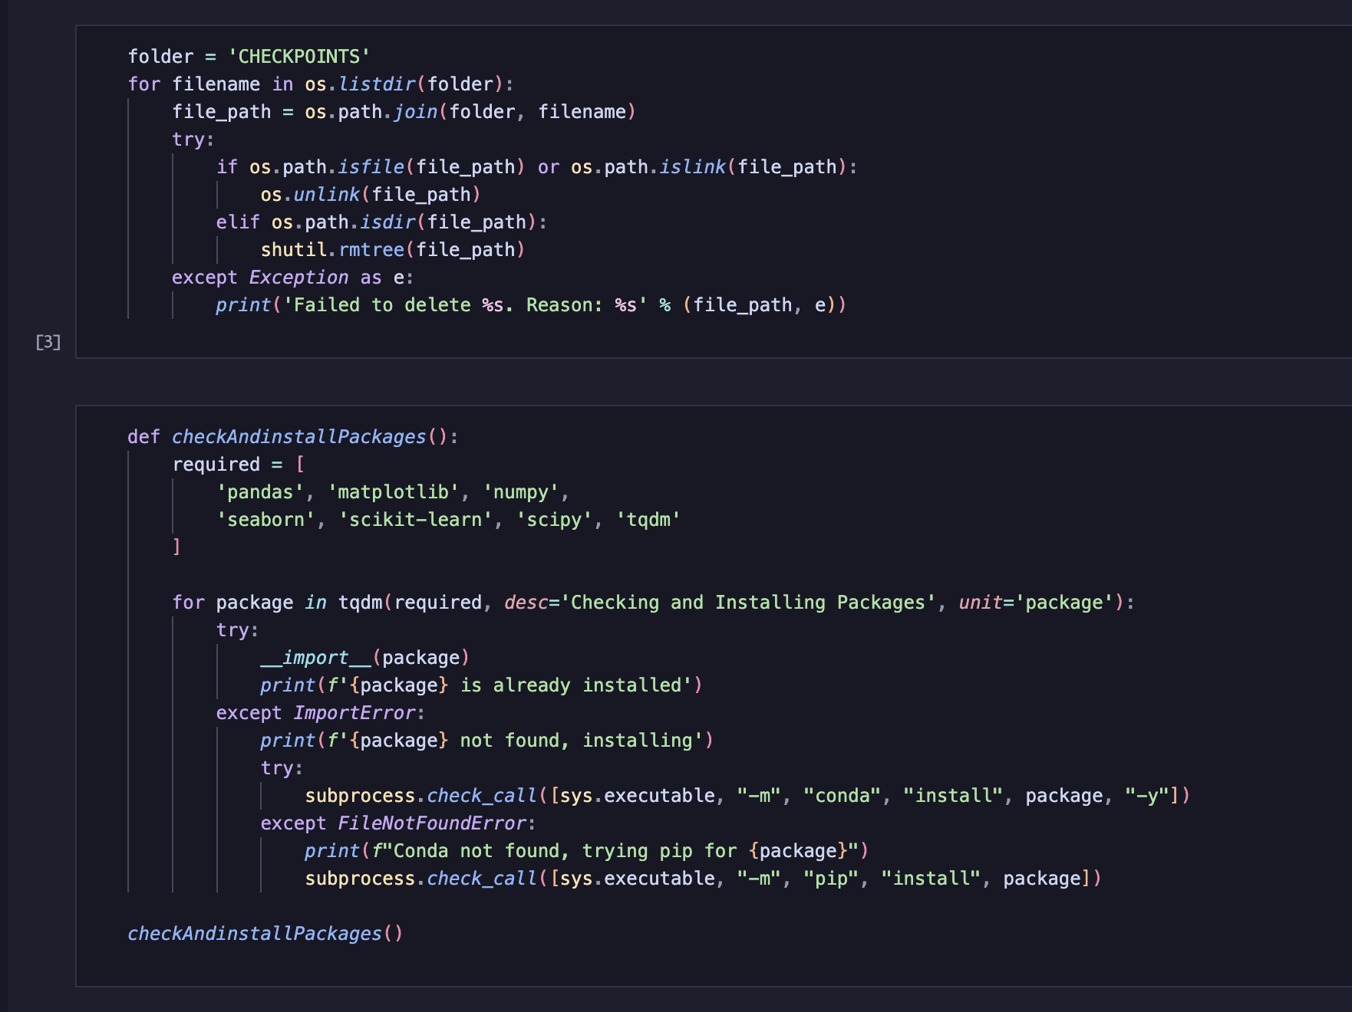
Checkpoint System

Slide 9
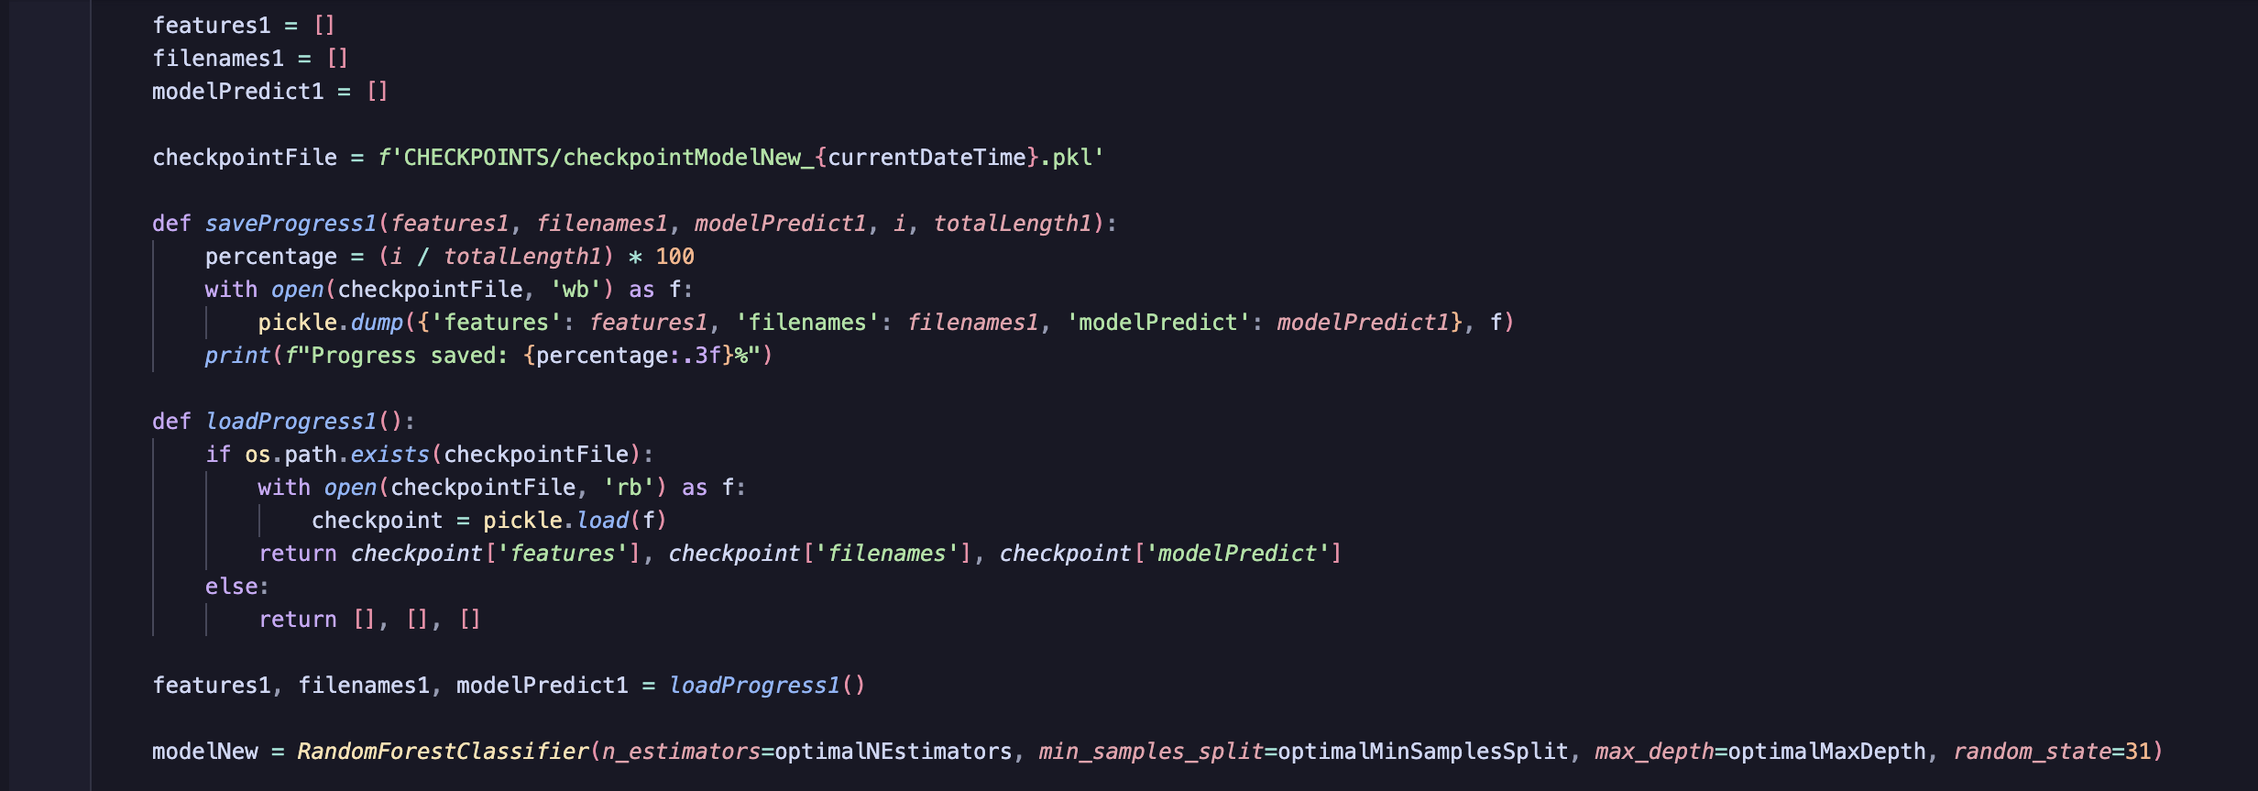
Checkpoint System in Action

Slide 10
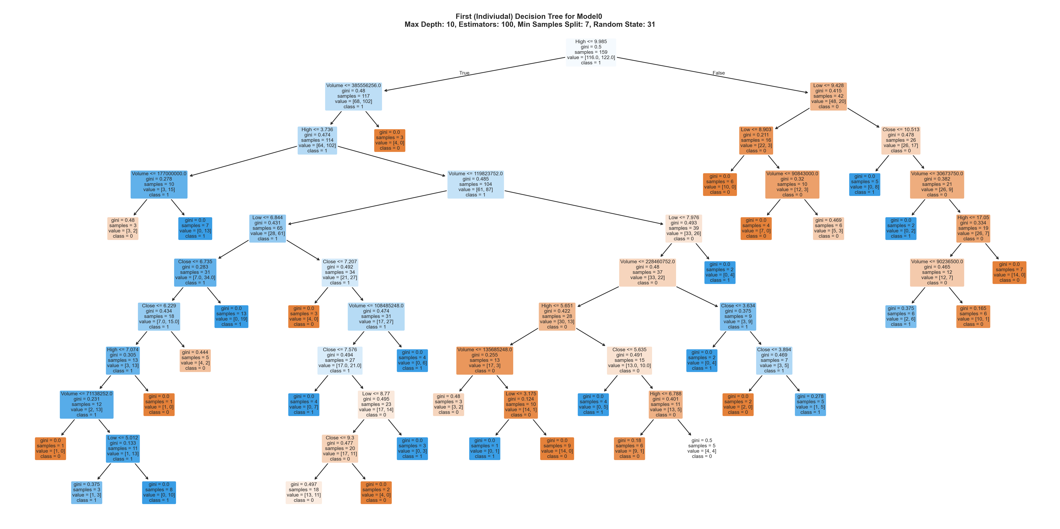
Decision Tree Visualisation (Model0)

Slide 11
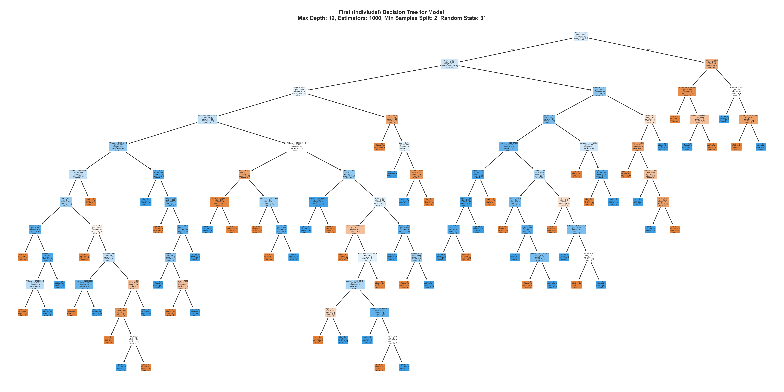
Decision Tree Visualisation (Model)

Slide 12

Decision Tree Visualisation (Model 1)
IndexError: list index out of range

Slide 13
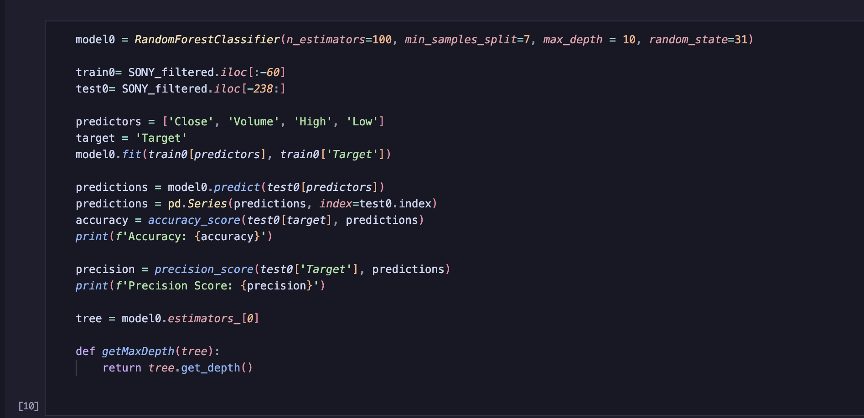
Model O

Slide 14
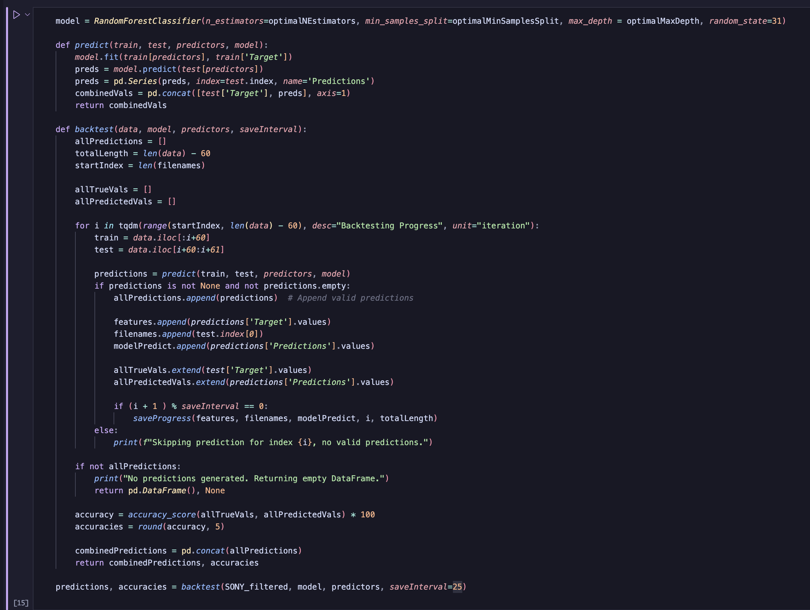
Model

Slide 15
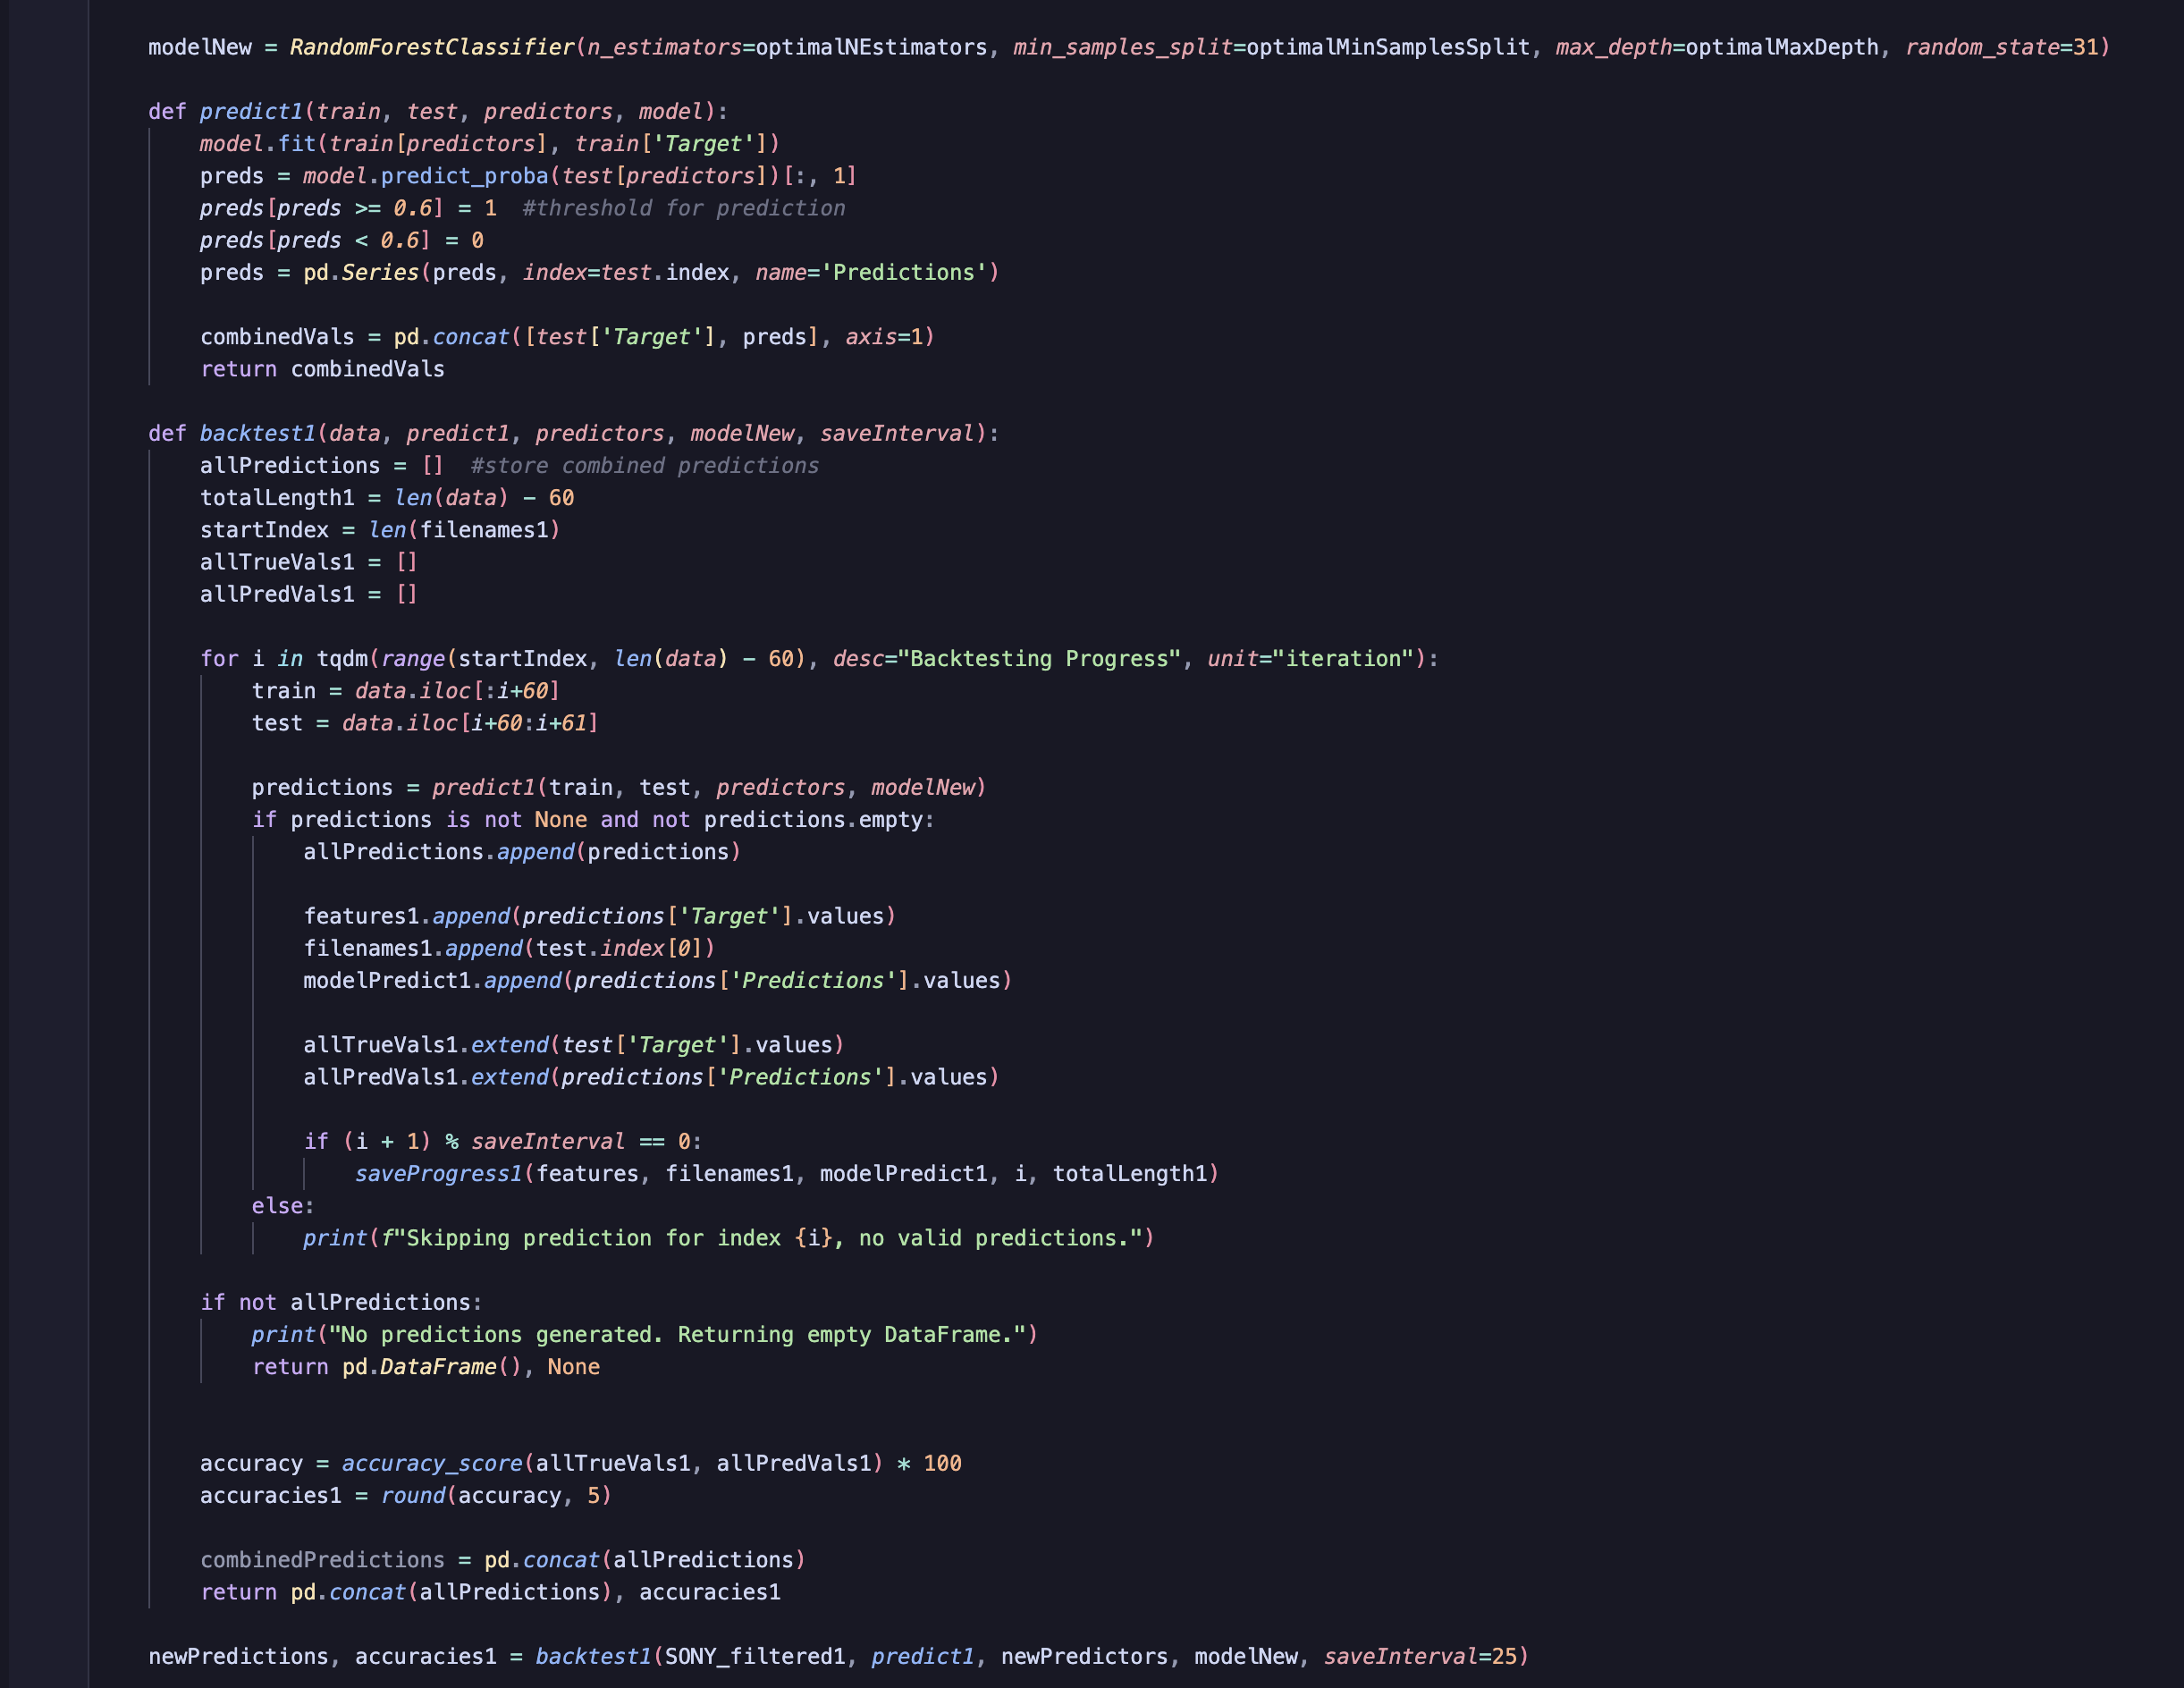
Model 1

Slide 16
RESULTS

Slide 17
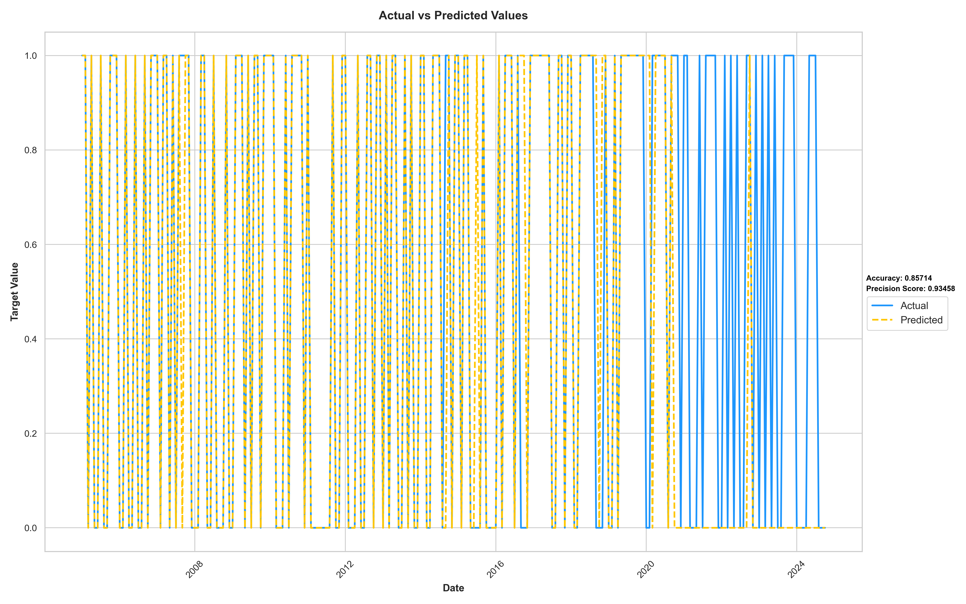

Slide 18
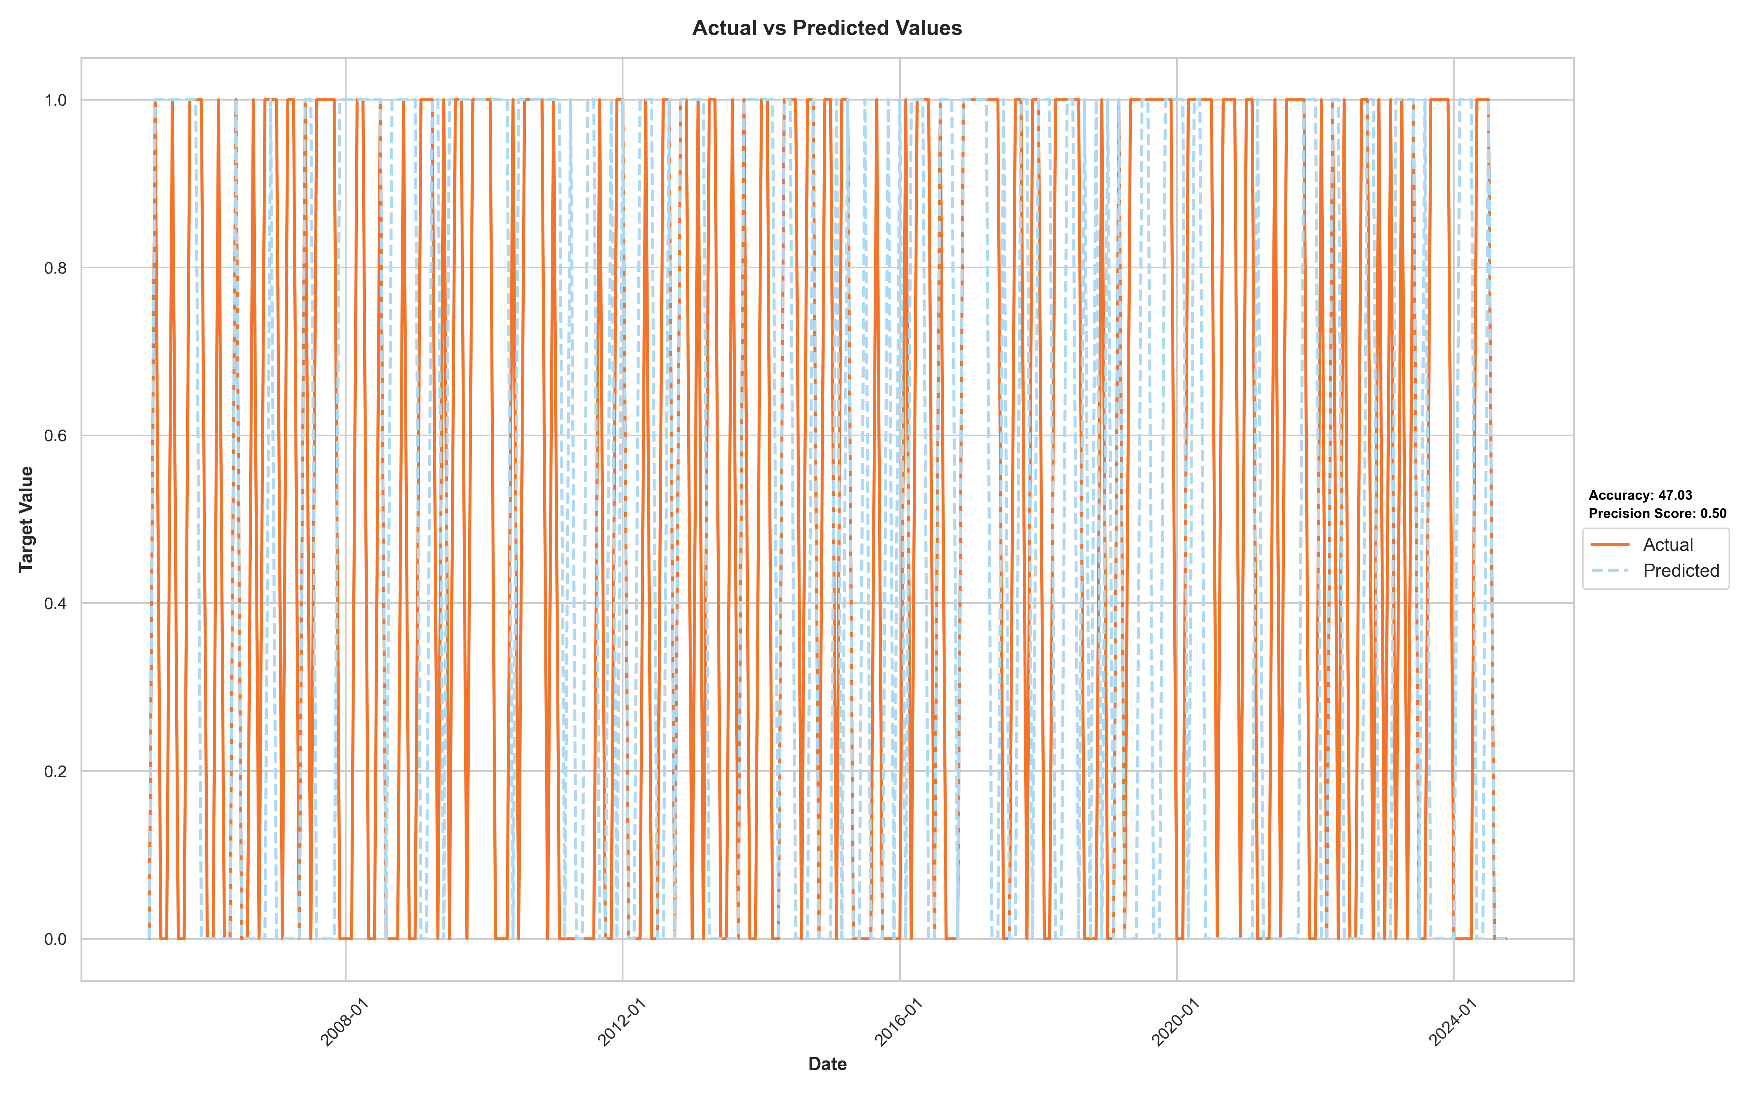

Slide 19
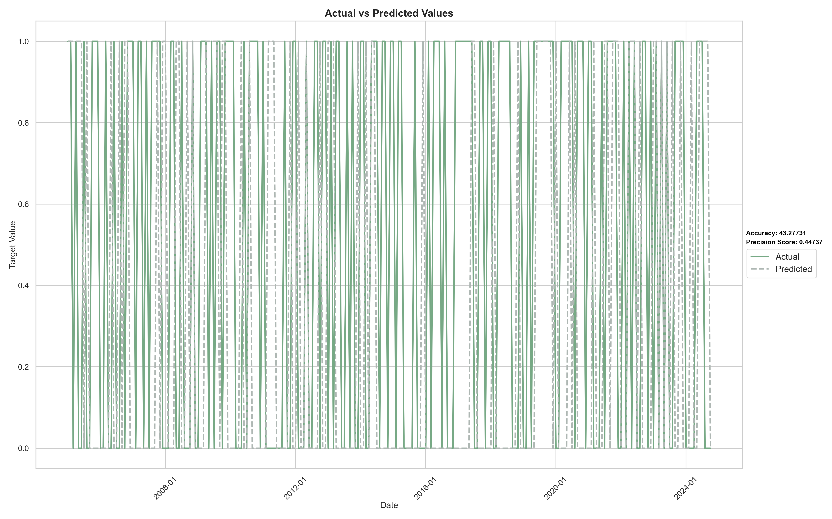

Slide 20

Link to Project and Questions?

